Slide 1
AUTONOMOUS SURVEILLANCE USING DRONES

Slide 2
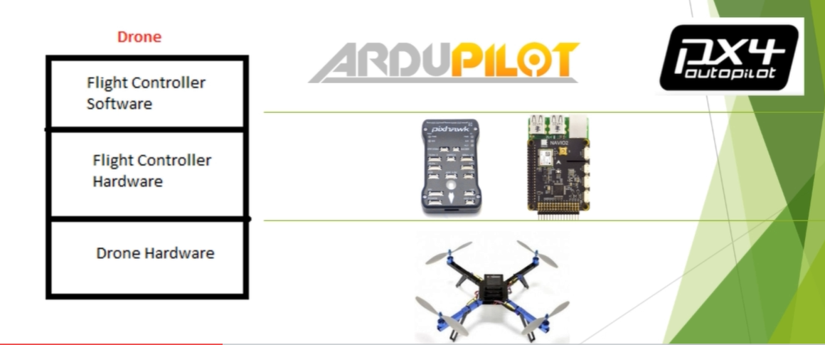
DRONE BASICS

Slide 3
Drone hardware consist of Frame ,Bldc Motor, Battery, propellers, ESC.
Flight control hardware acts as brain of drone, It accept all the command and process it. The normally used flight controller is Pixhawk.
Flight controller consist of IMU, Microprocessor etc.
Flight controller software: Different firmware's are uploaded into the flight controller.PX4 and Ardupilot are two companies that provide firmware

Slide 4
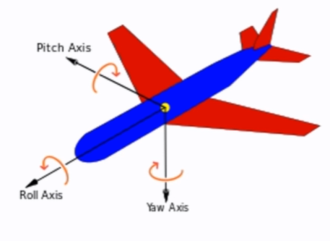
ROLL PITCH YAW

Slide 5
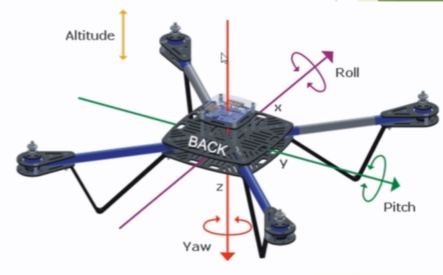
ROLL: It is the rotation along x axis.
PITCH: It is the rotation along y axis
YAW: It is the rotation along z axis

Slide 6
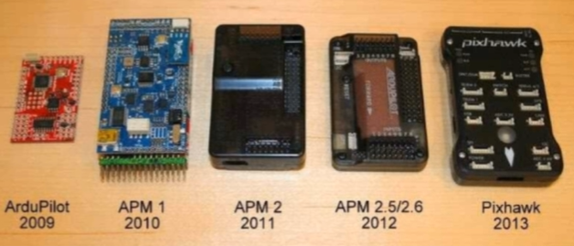
ARDUPILOT

Slide 7
Chris Anderson in 2007 made a drone for his kids. He later developed website diydrones.com
APM stands for ARDUPILOT MEGA
The improvements in code led to the development of new hardware
In 2013 3DR company along with PX4 introduced Pixhawk
APM is seldom used
Ardupilot now stands only for software

Slide 8
ARDUPILOT
It has 700,000 lines of code
It provides various flight modes
Ardupilot used Advanced Kalman filter to fuse all sensor readings into attitude/position
It support different vehicles such as multi-rotor, antenna tracker, rover

Slide 9
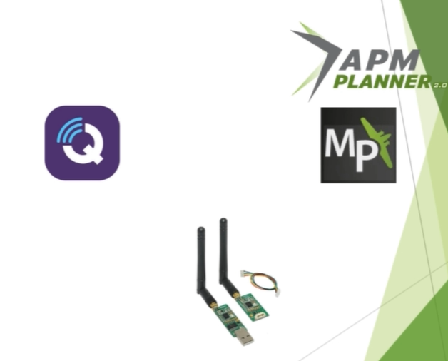
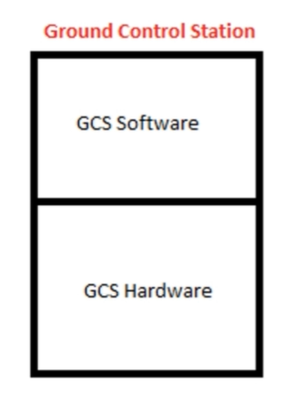
GROUND CONTOL STATIONS

Slide 10
GCS: It is an interface to drone that gives the pilot/drone a way of communicating with the drone
This interface can be used to command drone or simply receive information such as GPS signal health, Battery info, ground speed
GCS can refer to Ground control station high level software that present data with a GUI
It can be offboard computers which helps in bidirectional communication

Slide 11
MAVPROXY
It is a command line GCS that is lightweight
Open source GCS written in Python
No fancy button compared to Mission Planner, QGC ground control

Slide 12
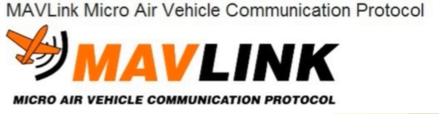
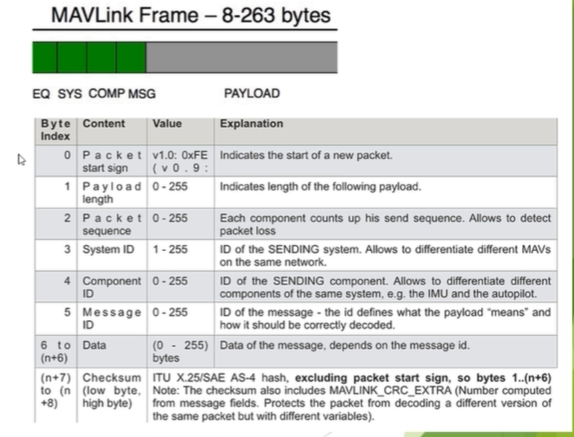
MAVLINK

Slide 13
ADAVANTAGES
Standardizes the communication protocol for sending info
Standardizes the types of messages that can be sent
Allows for bidirectional communication

Slide 14
Mavlink frame size can vary between 8-263 bytes
Packet start sign: if it doesn’t start with 0xFE it is not mavlink message
System ID :it could be compared to IP address,255-GCS.1-Drone
Component ID: Allows to differentiate system normally not used(when controlling Gimbals)
Message ID: it denotes the type of message

Slide 15
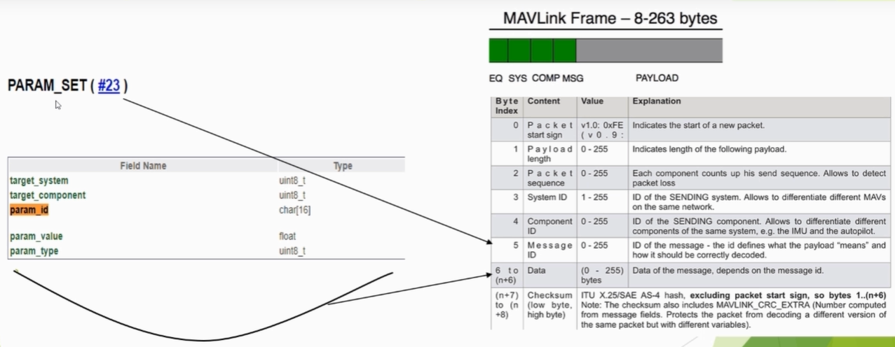
target system-1,target component-0

Slide 16
MODES
There are many modes supported by Ardupilot Platform.
The main modes that we need for our project is AUTO and GUIDED
GUIDED mode requires GPS, This mode is used to control drone without Remote control
AUTO mode requires GPS, in this mode we just load latitude, longitude to drone hardware when switched into AUTO mode it automatically flies to that position
RETURN TO LAUNCH mode requires GPS when switched into this mode it return backs to position where it was initially
LAND mode requires no GPS when switched into this mode it lands automatically
ALT HOLD requires no GPS it is used to maintain position using internal barometer present inside flight controller hardware

Slide 17
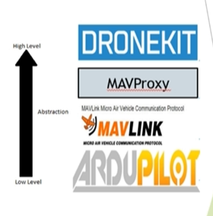
Dronekit
Python implementation of mavlink in the form of function
Gives us high level access to Low level autopilot firmware(Ardupilot and PX4)
User did not need to understand 700,000 lines of code

